Slide 1
Bulkcart – B2B Food Wholesale Platform
TEAM 1:
Abubakar Tahir - Project Manager Rohit Sai Chandrashekar - Product Owner Mansi Bhadani - Business Analyst Akash Verma - Lead Developer Kiran Rathod - Developer Arun Garwan - Developer Meet Mangukiya - DBA Asmith Mamilla – QA Analyst Vivek Vekhande - Software Tester Om Patil - Software Tester
CS691_CRN20976- Capstone Project

Slide 2
AGENDA
Application Overview
BRM Diagram
Context Diagram
RoadMap
RCT (main view only)
User Stories
UML Activity Diagram
ER Diagrams
Burndown Charts
Jenkins Progress Report
Live [Recorded] Application Demo

Slide 3
Application Overview (Arun Garwan )
Bulkcart is a B2B Grocery Procurement Portal connecting food retailers directly with wholesale suppliers — streamlining ordering, pricing, inventory, and invoicing in one unified platform.
The platform supports end-to-end workflows including supplier catalog management, purchase order creation with multi-level approval, inventory tracking, shipment management, and automated invoice generation.
It also features smart reorder suggestions based on purchase history, tiered pricing for retailers.

Slide 4
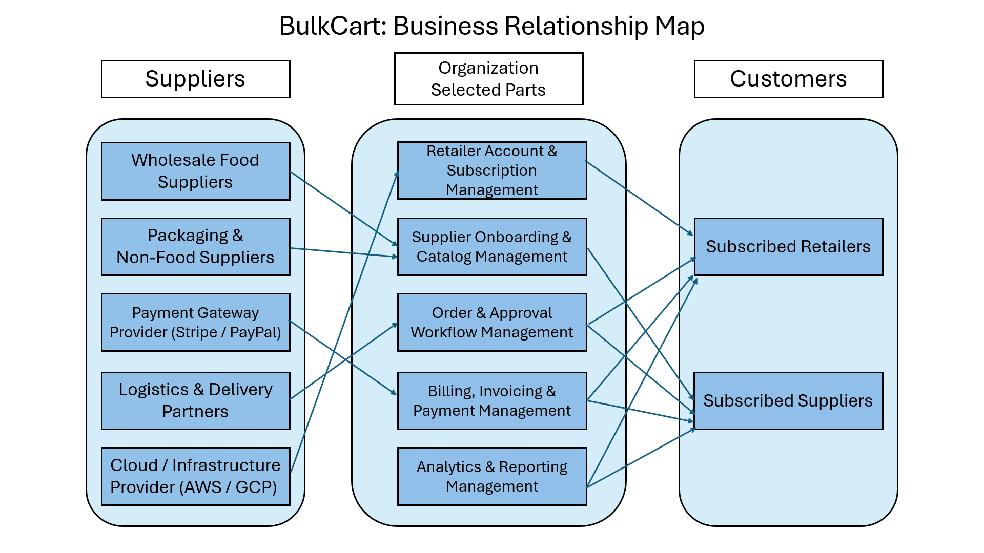
BRM DIAGRAM (Vivek Vekhande )

Slide 5
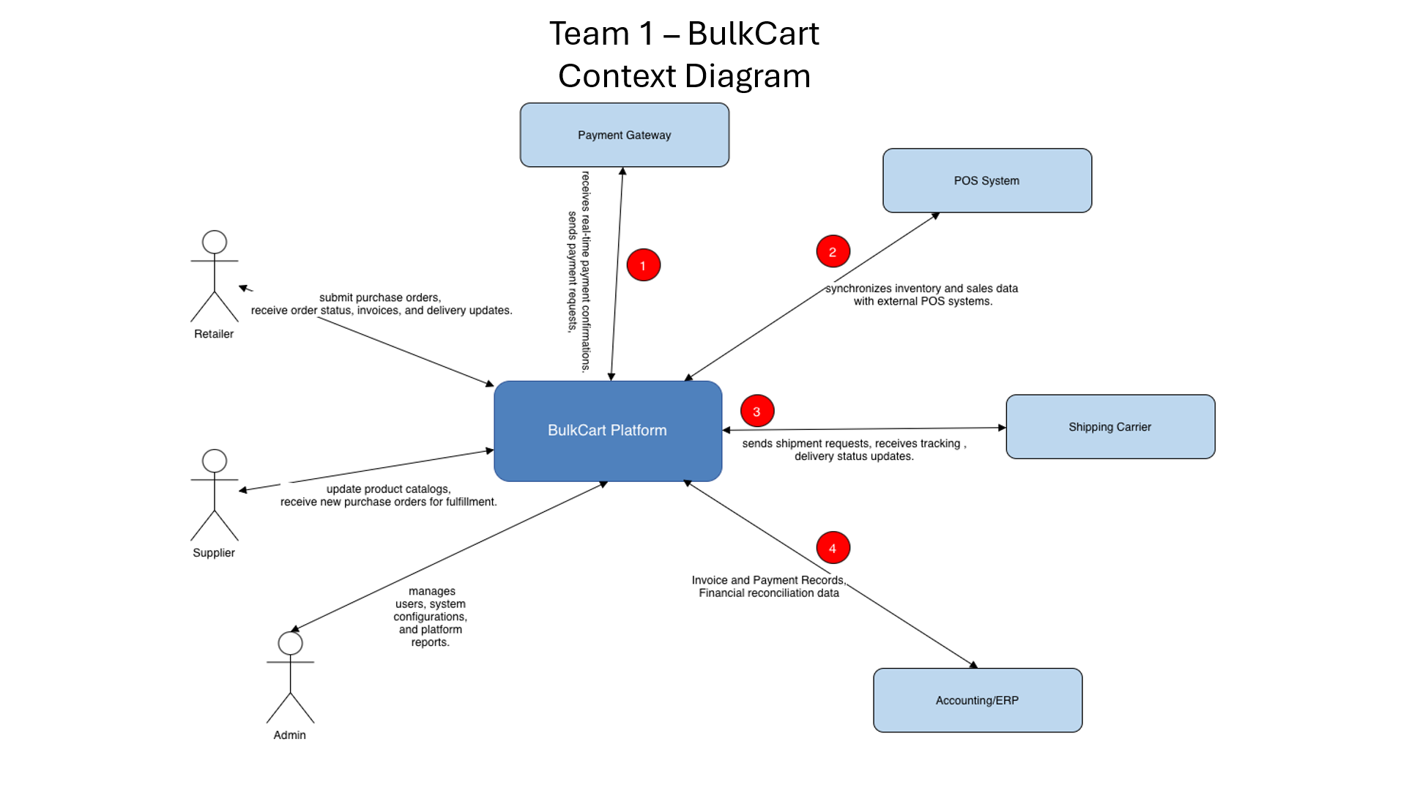
CONTEXT DIAGRAM (Om Kiran)

Slide 6
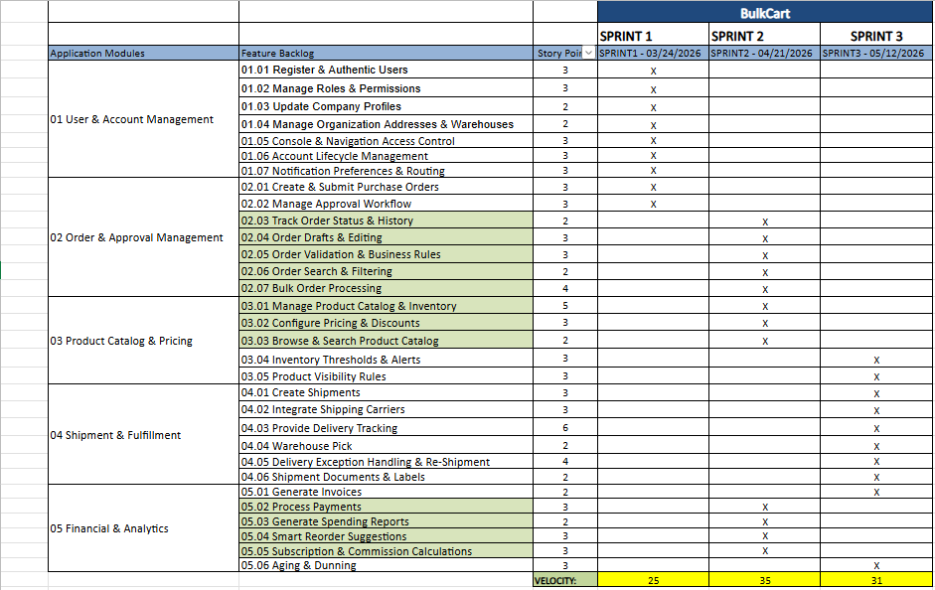
ROAD MAP (Rohit Chendrashekar)

Slide 7
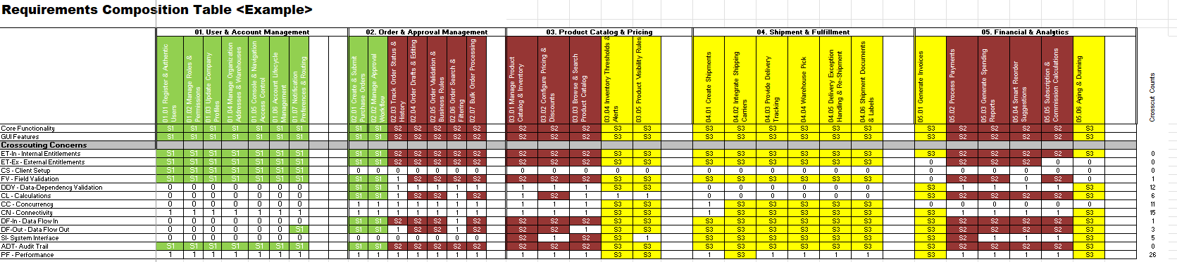
RCT: main view only (Abubakar Tahir)

Slide 8
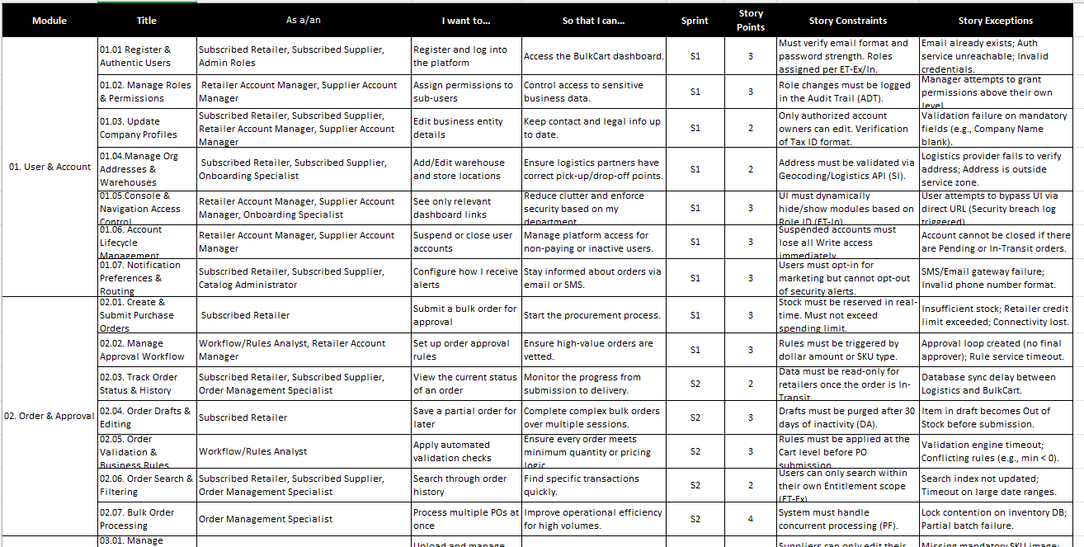
USER STORIES (Meet Mangukiya)

Slide 9
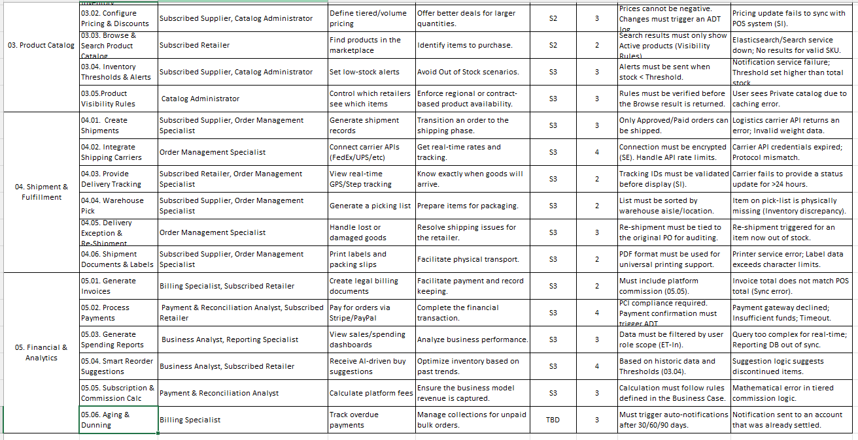
USER STORIES (Meet Mangukiya)

Slide 10
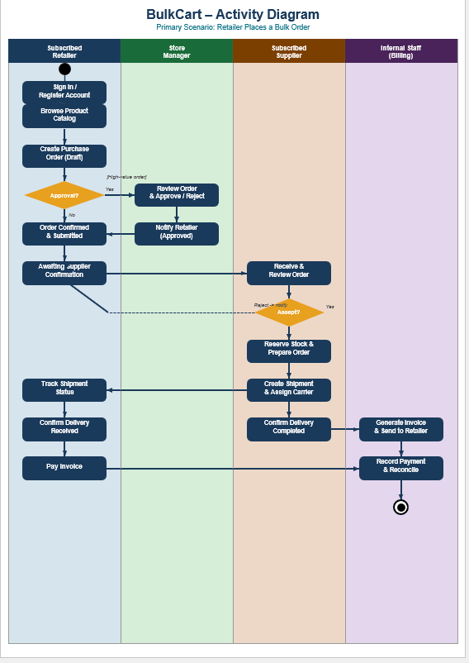
UML ACTIVITY DIAGRAM (Meet Mangukiya)

Slide 11
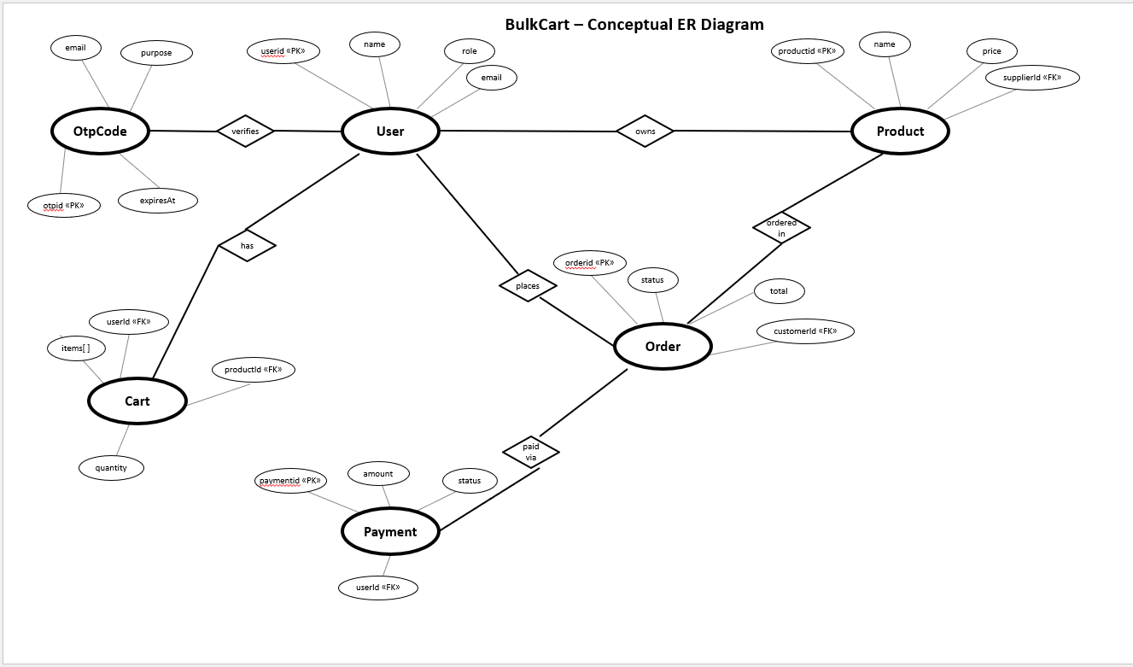
ER DIAGRAM (Asmith Mamilla)

Slide 12
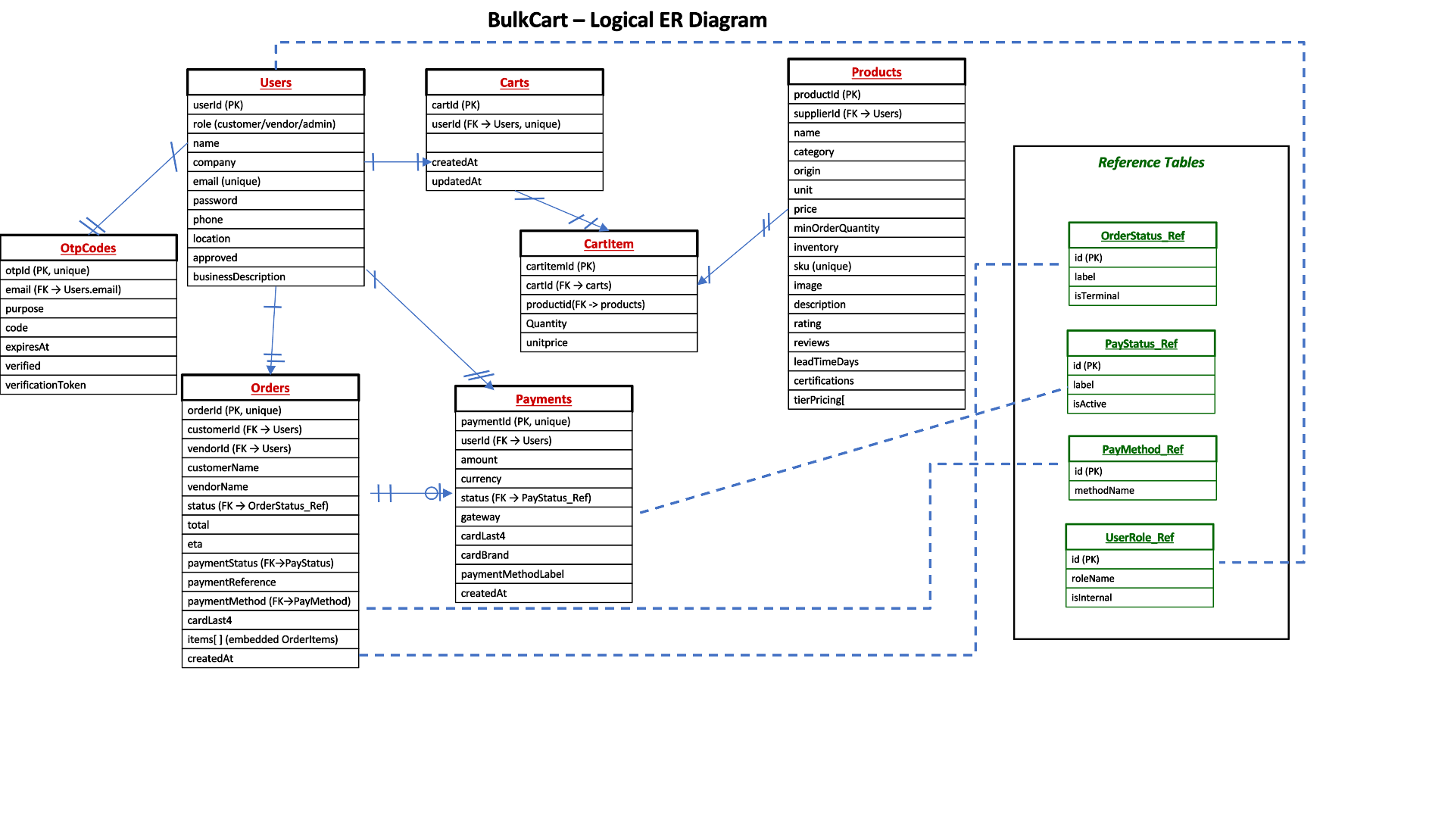
ER DIAGRAM (Asmith Mamilla)

Slide 13
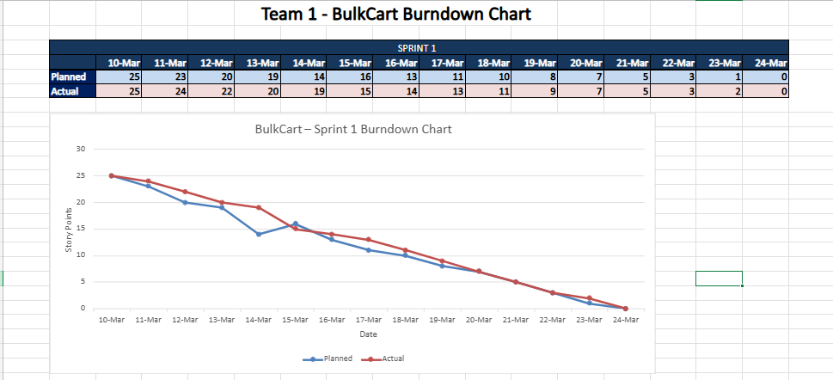
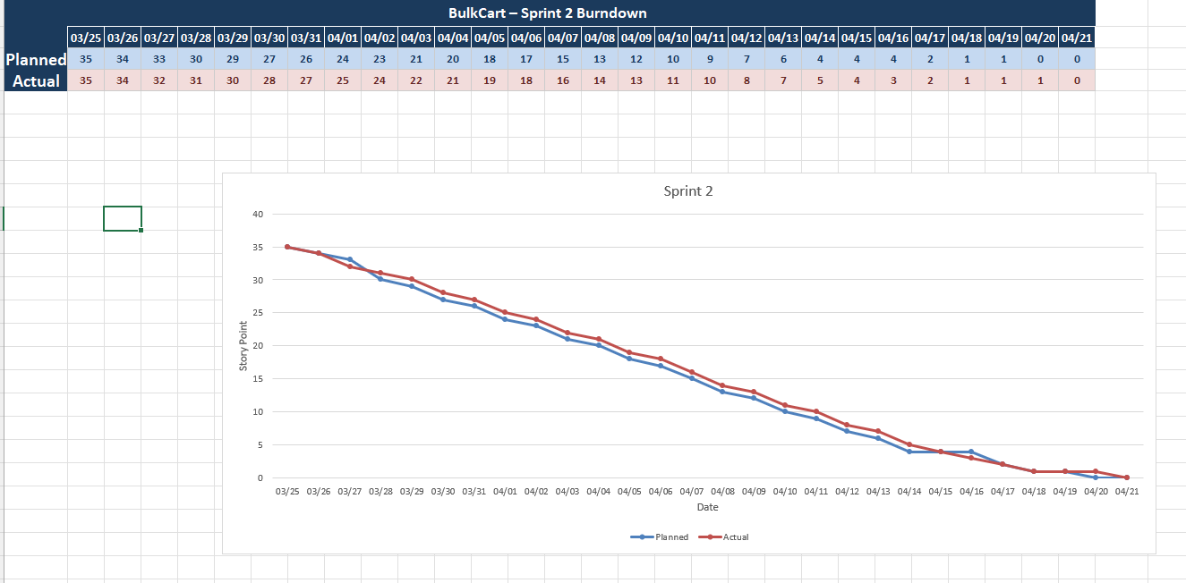
BURNDOWN CHARTS (Mansi Bhadani)
Sprint 1
Sprint 2

Slide 14
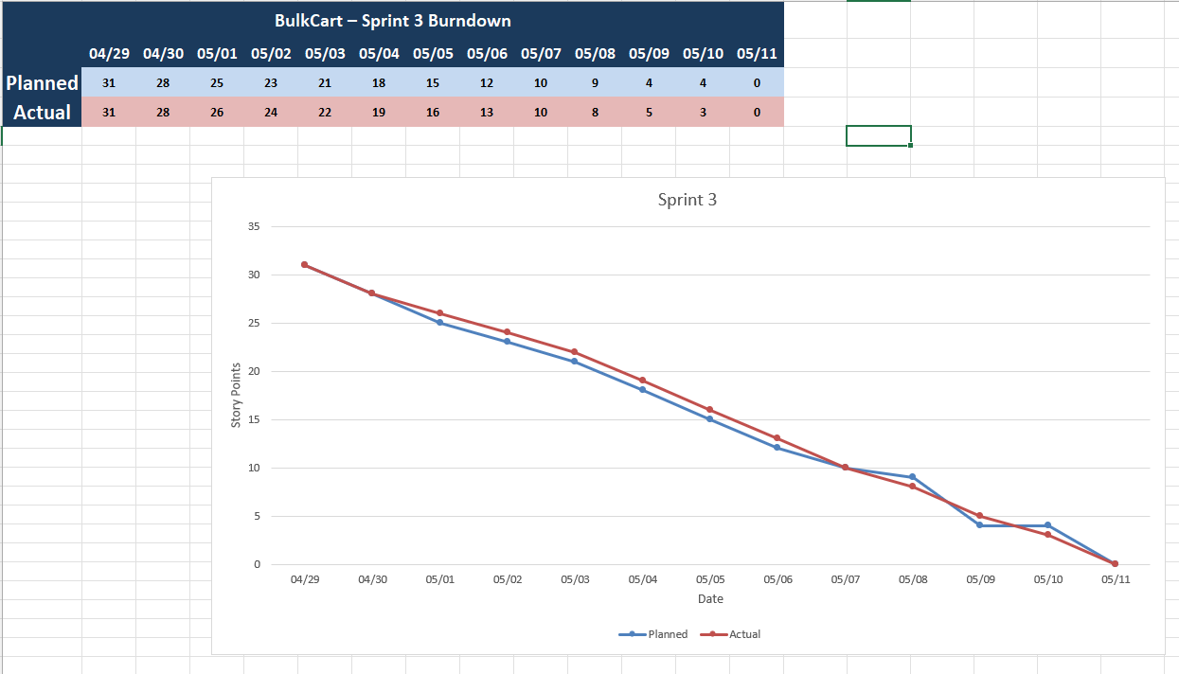
BURNDOWN CHARTS (Mansi Bhadani)
Sprint 3

Slide 15
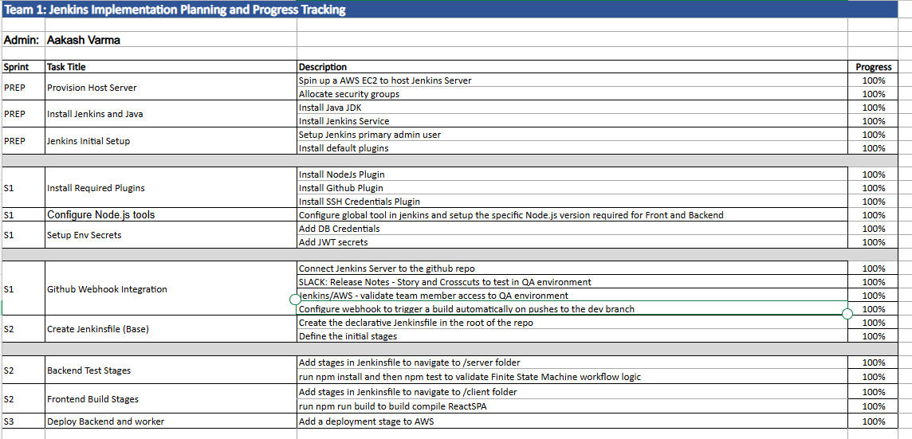
JENKINS PROGRESS REPORT (Aakash Verma)

Slide 16
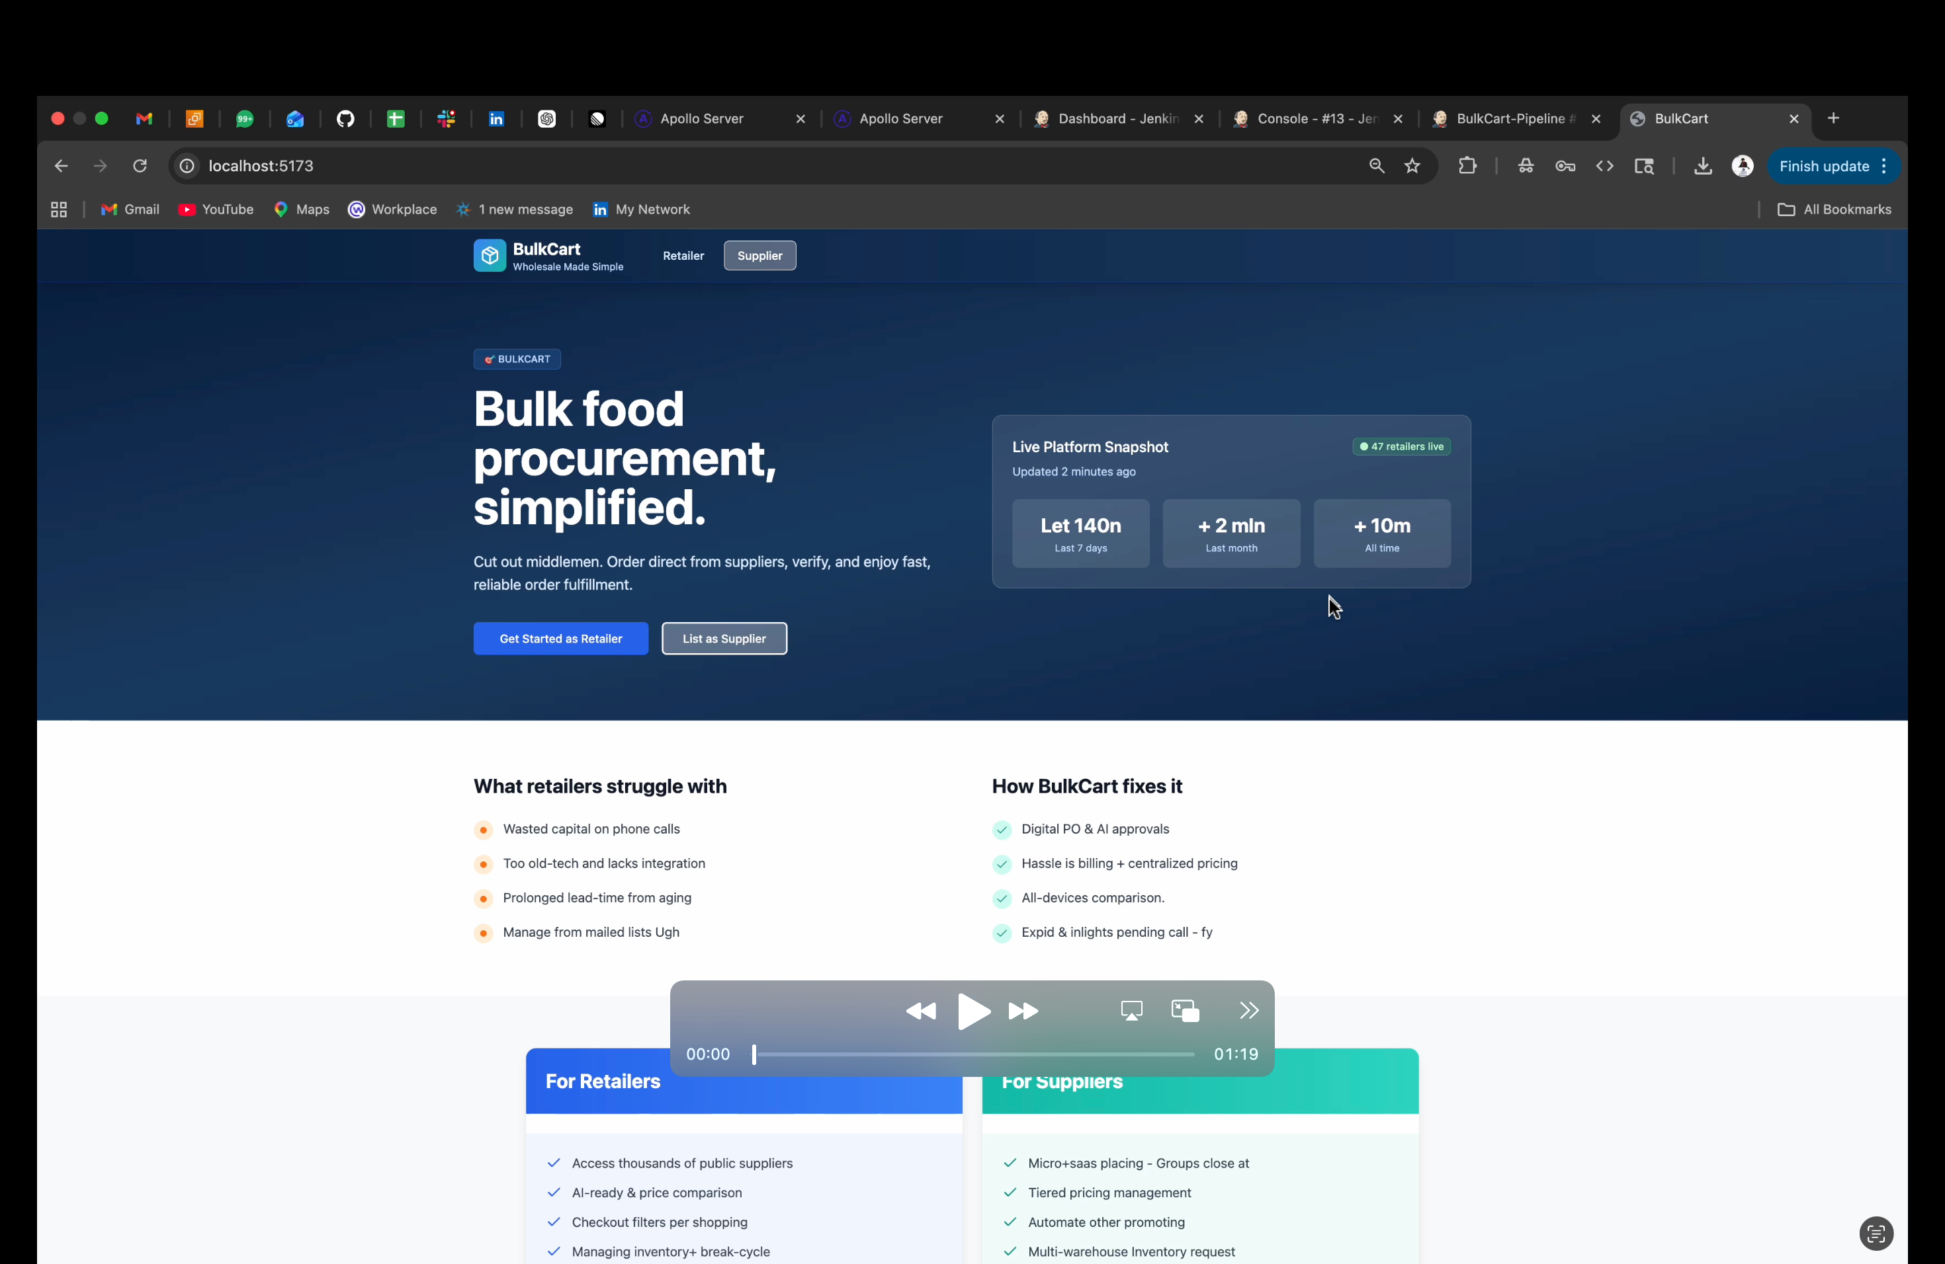
LIVE DEMO (Aakash Verma)

Slide 17
THANK YOU!

